Slide 1
CIO Slack Pilot
Guidelines and Introduction to Slack

Slide 2



Why Slack?
Since 2018, Treasury Board has supported the use of Slack throughout the GC for non-sensitive real-time messaging and collaboration
As anyone is able to freely make workspaces and invite colleagues to their workspace, the tool has risen dramatically in popularity across the GC.
As we work towards equipping the GC workforce with Collaboration Tools, we want to ensure we’re evaluating all the tools that people WANT to use.

Slide 3

What is the purpose of the Pilot?
Overall, the intent will be to learn about Slack from actual users. We want to share our experiences to help determine if procuring paid licenses for Slack is something we should be considering for SSC.
We will assess a number of things, such as:
Overlaps with O365
How Slack impacts your day - did it bring value? was it a distraction?
Accessibility
Security
User experience on work and personal devices
How is Slack being used in other Departments (Transport Canada, Canadian Digital Services, Natural Resources Canada)

Slide 4

Pilot volunteer expectations
Thank you for volunteering!
As volunteers, we have a few expectations and instructions to ensure that this pilot is a success:
Create an account for Slack and actively coordinate with the members of your team to participate
Contribute to the public channels on a consistent basis and that you use Slack on a daily basis.
Provide us with feedback, suggestions and ideas at any time in the #cio-office channel
Answer survey(s) and participate in any feedback sessions organized through the pilot

Slide 5

Slack Code of Conduct
Because this is a free slack account, we have limited history, but Slack - the company - retains complete logs of all channels and direct message.
Slack is a U.S. company and therefore data is held in the U.S. and subject to their laws. All communication in slack is strictly limited non-sensitive data only.
We want this to be a fun, pleasant, and harassment-free experience for everyone, regardless of gender, gender identity and expression, sexual orientation, disability, physical appearance, body size, race, or religion. We do not tolerate harassment of participants in any form.

Slide 6
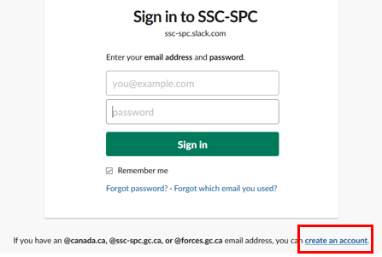
How do I register?
Some of your wonderful colleagues took the initiative to get a Slack workspace started. Instead of creating a new one for the purposes of this pilot, we’re going to use one that already exists!
Register here: https://ssc-spc.slack.com/
Register with your Canada.ca email address
Follow the instructions provided by Slack

Slide 7
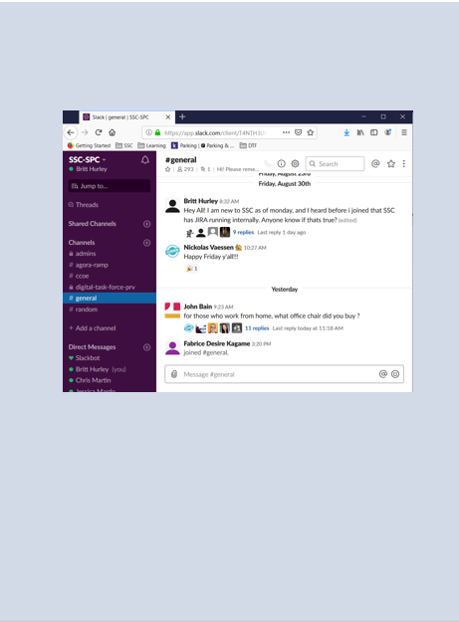
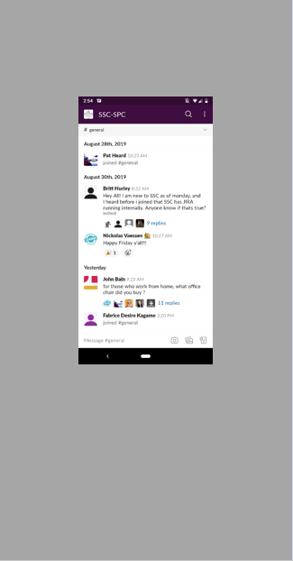
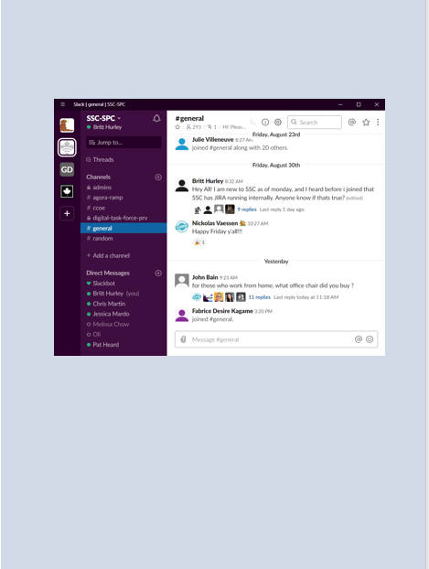
Available Slack Platforms
Browser
Mobile
Desktop application
Navigate to https://ssc-spc.slack.com/
Leave the browser window open, and optionally turn on notifications.
Download from the Apple, or Android play store on your Personal or Work phone.
Download Slack for Windows https://slack.com/intl/en-ca/downloads/windows
Best option for integration with your work day.

Slide 8



Slack Tips & Tricks
Browse all available channels by clicking on Channels, or create a new channel by clicking on the + icon next to Channels.
Invite people to a workspace by clicking on + Invite people - Slack will send an invitation to the person in question via email
Need to ignore Slack notifications for a while? Enter Do Not Disturb mode by selecting the snooze notification icon in the top left corner
Slack is a pretty great company, and they offer up a lot of information on how to use their product! To learn about more cool things Slack can do, check out their Help Center
https://get.slack.help/hc/en-us

Slide 9
Slack Pilot FAQ
When does the pilot end?
We’re currently aiming to finish this pilot by the end of December, but if more time is needed to gather the information needed we can extend that date.
How do we give feedback?
Towards the end of the pilot, we will be sending out a survey to gather your feedback. However, you can contact us anytime in #cio-office channel, or send an email to jessica.mardo@canada.ca or heraldo.jacques@canada.ca

